Slide 1
Section 2.3 – Authentication Technologies

Slide 2
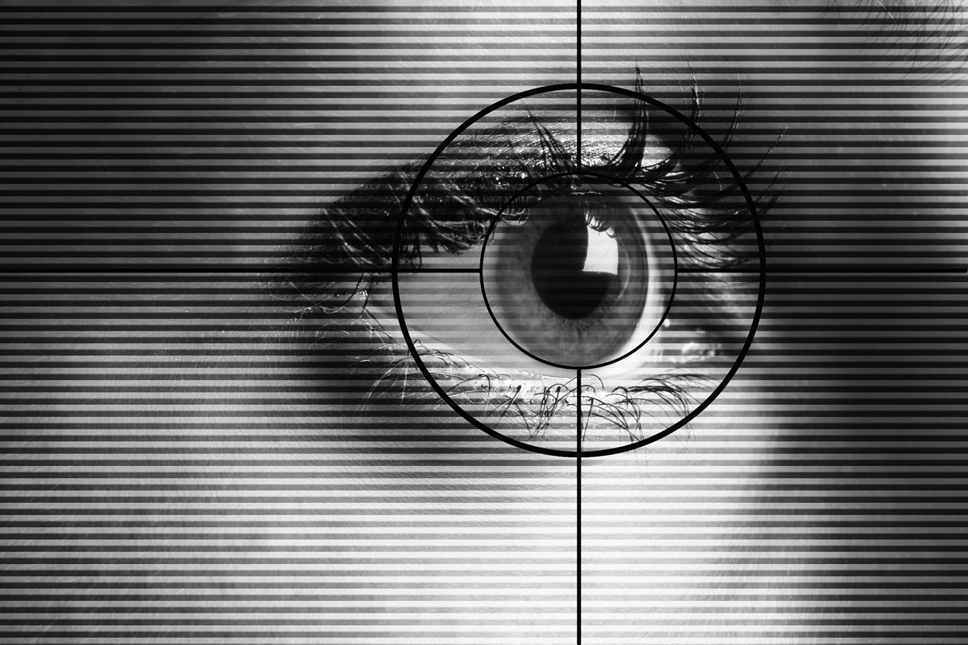
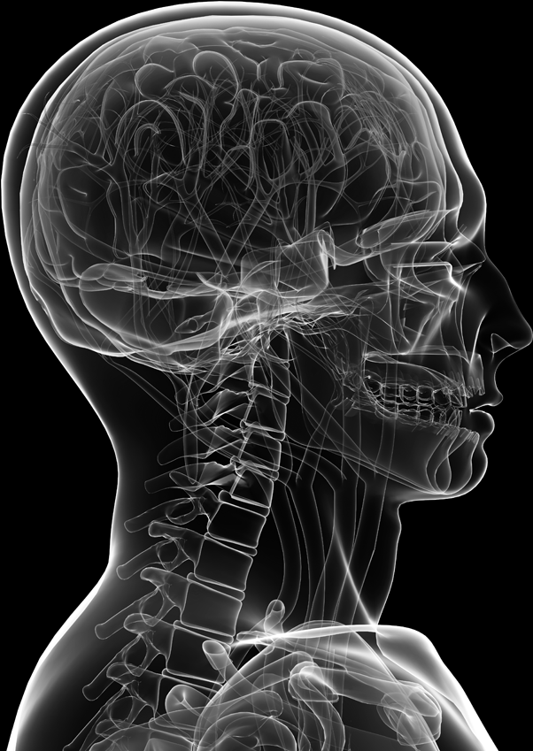
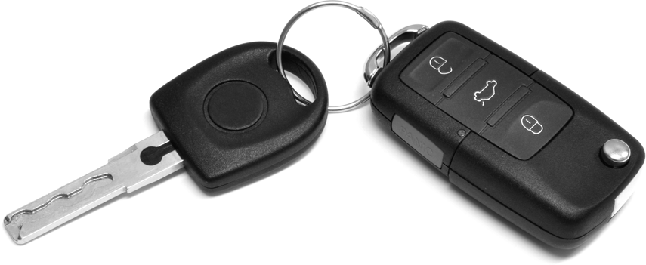
Authentication
The determination of identity, usually based on a combination of
something the person has (like a smart card or a radio key fob storing secret keys),
something the person knows (like a password),
something the person is (like a human with a fingerprint).
password=ucIb()w1V
mother=Jones
pet=Caesar
human with fingers
and eyes
Something you are
Something you know
radio token with
secret keys
Something you have

Slide 3
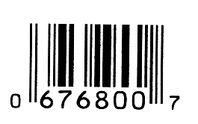
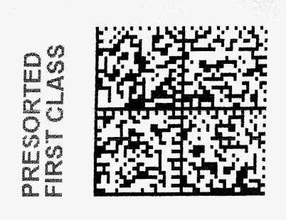
Barcodes
Developed in the 20th century to improve efficiency in grocery checkout.
First-generation barcodes represent data as a series of variable-width, vertical lines of ink, which is essentially a one-dimensional encoding scheme.
Some more recent barcodes are rendered as two-dimensional patterns using dots, squares, or other symbols that can be read by specialized optical scanners, which translate a specific type of barcode into its encoded information.

Slide 4
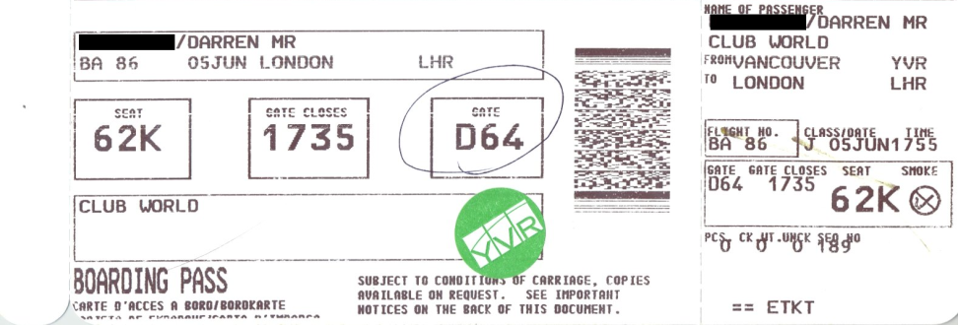
Authentication via Barcodes
Since 2005, the airline industry has been incorporating two-dimensional barcodes into boarding passes, which are created at flight check-in and scanned before boarding.
In most cases, the barcode is encoded with an internal unique identifier that allows airport security to look up the corresponding passenger’s record with that airline.
Staff then verifies that the boarding pass was in fact purchased in that person’s name (using the airline’s database), and that the person can provide photo identification.
In most other applications, however, barcodes provide convenience but not security. Since barcodes are simply images, they are extremely easy to duplicate.
Two-dimensional
barcode
Public domain image from http://commons.wikimedia.org/wiki/File:Bpass.jpg

Slide 5
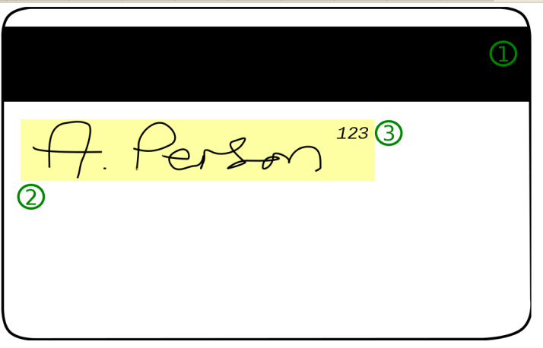
Magnetic Stripe Cards
Plastic card with a magnetic stripe containing personalized information about the card holder.
The first track of a magnetic stripe card contains the cardholder’s full name in addition to an account number, format information, and other data.
The second track may contain the account number, expiration date, information about the issuing bank, data specifying the exact format of the track, and other discretionary data.
Public domain image by Alexander Jones from http://commons.wikimedia.org/wiki/File:CCardBack.svg

Slide 6
Magnetic Stripe Card Security
One vulnerability of the magnetic stripe medium is that it is easy to read and reproduce.
Magnetic stripe readers can be purchased at relatively low cost, allowing attackers to read information off cards.
When coupled with a magnetic stripe writer, which is only a little more expensive, an attacker can easily clone existing cards.
So, many uses require card holders to enter a PIN to use their cards (e.g., as in ATM and debit cards in the U.S.).
Public domain image by Alexander Jones from http://commons.wikimedia.org/wiki/File:CCardBack.svg

Slide 7
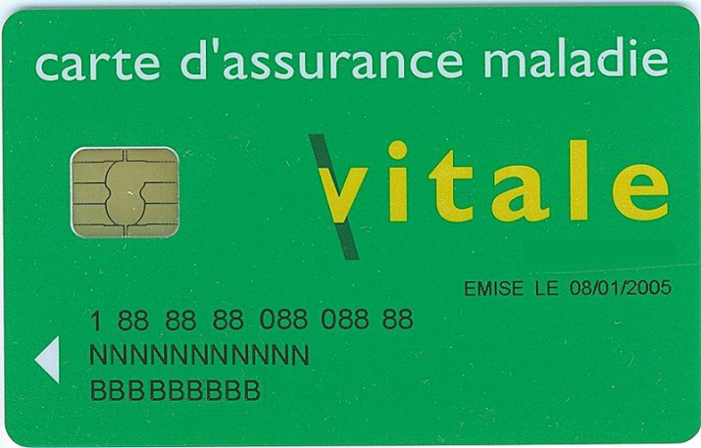
Smart Cards
Smart cards incorporate an integrated circuit, optionally with an on-board microprocessor, which microprocessor features reading and writing capabilities, allowing the data on the card to be both accessed and altered.
Smart card technology can provide secure authentication mechanisms that protect the information of the owner and are extremely difficult to duplicate.
Circuit interface
Public domain image from http://en.wikipedia.org/wiki/File:Carte_vitale_anonyme.jpg

Slide 8
Smart Card Authentication
They are commonly employed by large companies and organizations as a means of strong authentication using cryptography.
Smart cards may also be used as a sort of “electronic wallet,” containing funds that can be used for a variety of services, including parking fees, public transport, and other small retail transactions.

Slide 9
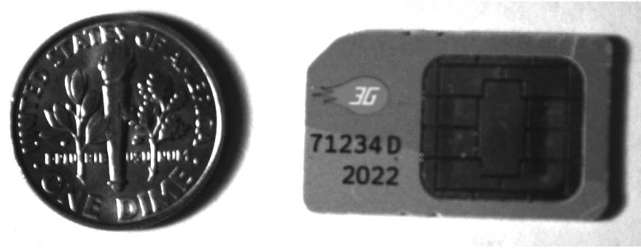
SIM Cards
Many mobile phones use a special smart card called a subscriber identity module card (SIM card).
A SIM card is issued by a network provider. It maintains personal and contact information for a user and allows the user to authenticate to the cellular network of the provider.

Slide 10
SIM Card Security
SIM cards contain several pieces of information that are used to identify the owner and authenticate to the appropriate cell network.
Each SIM card corresponds to a record in the database of subscribers maintained by the network provider.
A SIM card features an integrated circuit card ID (ICCID),
which is a unique 18-digit number used for hardware identification.
Next, a SIM card contains a unique international mobile subscriber identity (IMSI), which identifies the owner’s country, network, and personal identity.
SIM cards also contain a 128-bit secret key. This key is used for authenticating a phone to a mobile network.
As an additional security mechanism, many SIM cards require a PIN before allowing any access to information on the card.

Slide 11
GSM Challenge-Response Protocol
When a cellphone wishes to join a cellular network it connects to a local base station owned by the network provider and transmits its IMSI.
If the IMSI matches a subscriber’s record in the network provider’s database, the base station transmits a 128-bit random number to the cellphone.
This random number is then encoded by the cellphone with the subscriber’s secret key stored in the SIM card using a proprietary encryption algorithm known as A3, resulting in a ciphertext that is sent back to the base station.
The base station then performs the same computation, using its stored value for the subscriber’s secret key. If the two ciphertexts match, the cellphone is authenticated to the network and is allowed to make and receive calls.
IMSI = (this phone’s ID)
R = a 128-bit random number (the challenge)
E_{K}(R) = the 128-bit random number encrypted
using the subscriber’s secret key K
(the response)

Slide 12
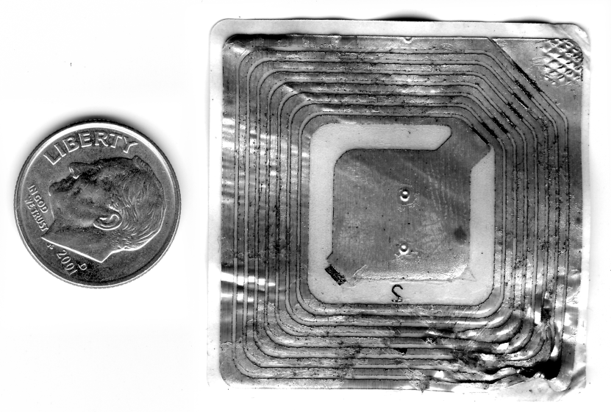
RFIDs
Radio frequency identification, or RFID, is a rapidly emerging technology that relies on small transponders to transmit identification information via radio waves.
RFID chips feature an integrated circuit for storing information, and a coiled antenna to transmit and receive a radio signal.

Slide 13
RFID Technology
RFID tags must be used in conjunction with a separate reader or writer.
While some RFID tags require a battery, many are passive and do not.
The effective range of RFID varies from a few centimeters to several meters, but in most cases, since data is transmitted via radio waves, it is not necessary for a tag to be in the line of sight of the reader.

Slide 14
RFID Technology
This technology is being deployed in a wide variety of applications.
Many vendors are incorporating RFID for consumer-product tracking.
Car key fobs.
Electronic toll transponders.

Slide 15
Passports
Modern passports of several countries, including the United States, feature an embedded RFID chip that contains information about the owner, including a digital facial photograph that allows airport officials to compare the passport’s owner to the person who is carrying the passport.
RFID chip and
antenna is embedded
in the cover
e-Passport
symbol

Slide 16
Passport Security
In order to protect the sensitive information on a passport, all RFID communications are encrypted with a secret key.
In many instances, however, this secret key is merely the passport number, the holder’s date of birth, and the expiration date, in that order.
All of this information is printed on the card, either in text or using a barcode or other optical storage method.
While this secret key is intended to be only accessible to those with physical access to the passport, an attacker with information on the owner, including when their passport was issued, may be able to easily reconstruct this key, especially since passport numbers are typically issued sequentially.

Slide 17
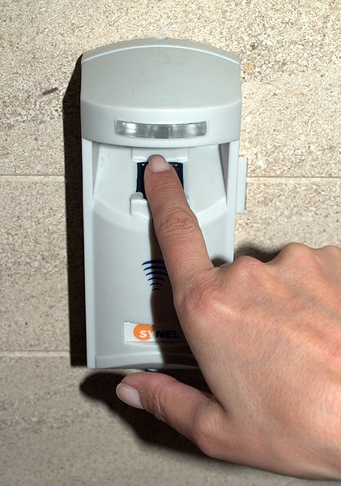
Biometrics
Biometric refers to any measure used to uniquely identify a person based on biological or physiological traits.
Generally, biometric systems incorporate some sort of sensor or scanner to read in biometric information and then compare this information to stored templates of accepted users before granting access.
Image from http://commons.wikimedia.org/wiki/File:Fingerprint_scanner_in_Tel_Aviv.jpg used with permission under the Creative Commons Attribution 3.0 Unported license

Slide 18
Requirements for Biometric Identification
Universality. Almost every person should have this characteristic.
Distinctiveness. Each person should have noticeable differences in the characteristic.
Permanence. The characteristic should not change significantly over time.
Collectability. The characteristic should have the ability to be effectively determined and quantified.

Slide 19
Biometric Identification
Reader
Biometric
Feature vector
Comparison algorithm
Reference vector
matches
doesn’t match

Slide 20
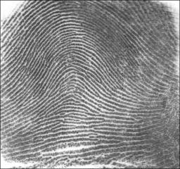
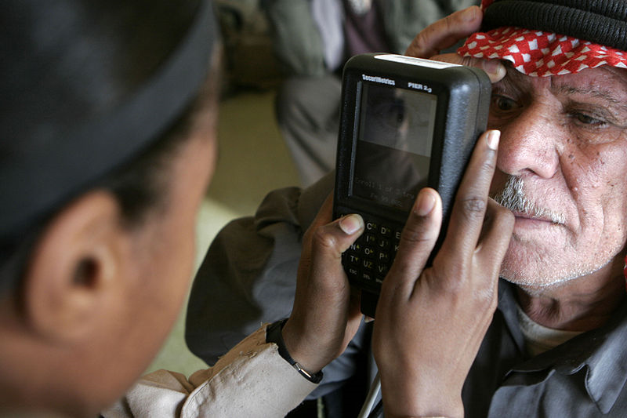
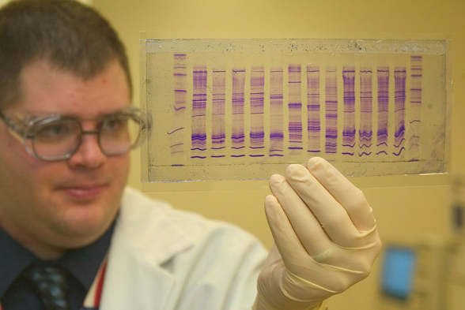
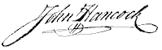
Candidates for Biometric IDs
Fingerprints
Retinal/iris scans
DNA
“Blue-ink” signature
Voice recognition
Face recognition
Gait recognition
Let us consider how each of these scores in terms of universality, distinctiveness, permanence, and collectability…
Public domain image from
http://commons.wikimedia.org/wiki/File:Fingerprint_Arch.jpg
Public domain image from
http://commons.wikimedia.org/wiki/File:Retinal_scan_securimetrics.jpg
Public domain image from
http://commons.wikimedia.org/wiki/File:CBP_chemist_reads_a_DNA_profile.jpg

